Slide 1
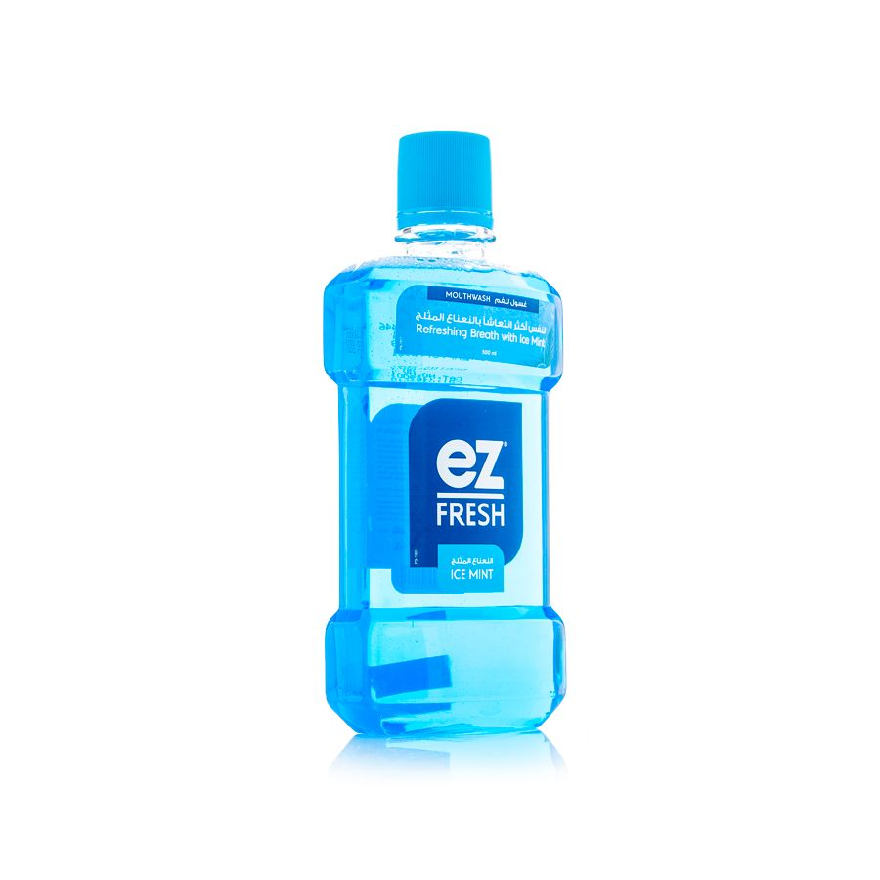
Easy Fresh Mouthwash Green Tea 500ml
500ml
41.40 SAR. Q

Slide 2
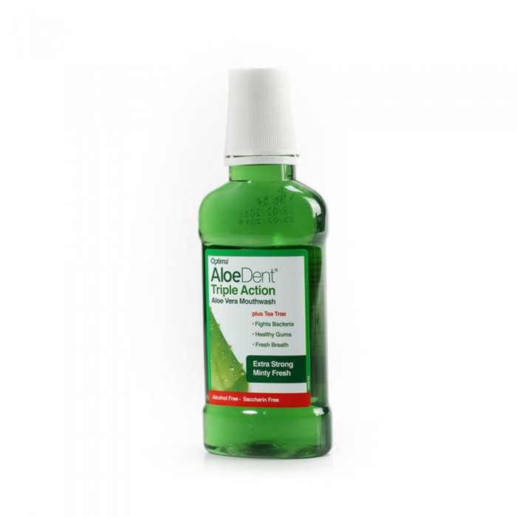
Wadunt Mouthwash Triple Effect Natural Aloe Vera 250 ml
24.95 SAR. Q
- Mouthwash with natural aloe vera provides white teeth and healthy gums. It contains many natural ingredients such as grapefruit, tea tree and xylitol.
- Mint also provides a refreshing breath.
- The product is free of alcohol, fluoride and SLS (cleaning additive) and is effective against bacteria, plaques, tooth decay, lime and bad breath

Slide 3
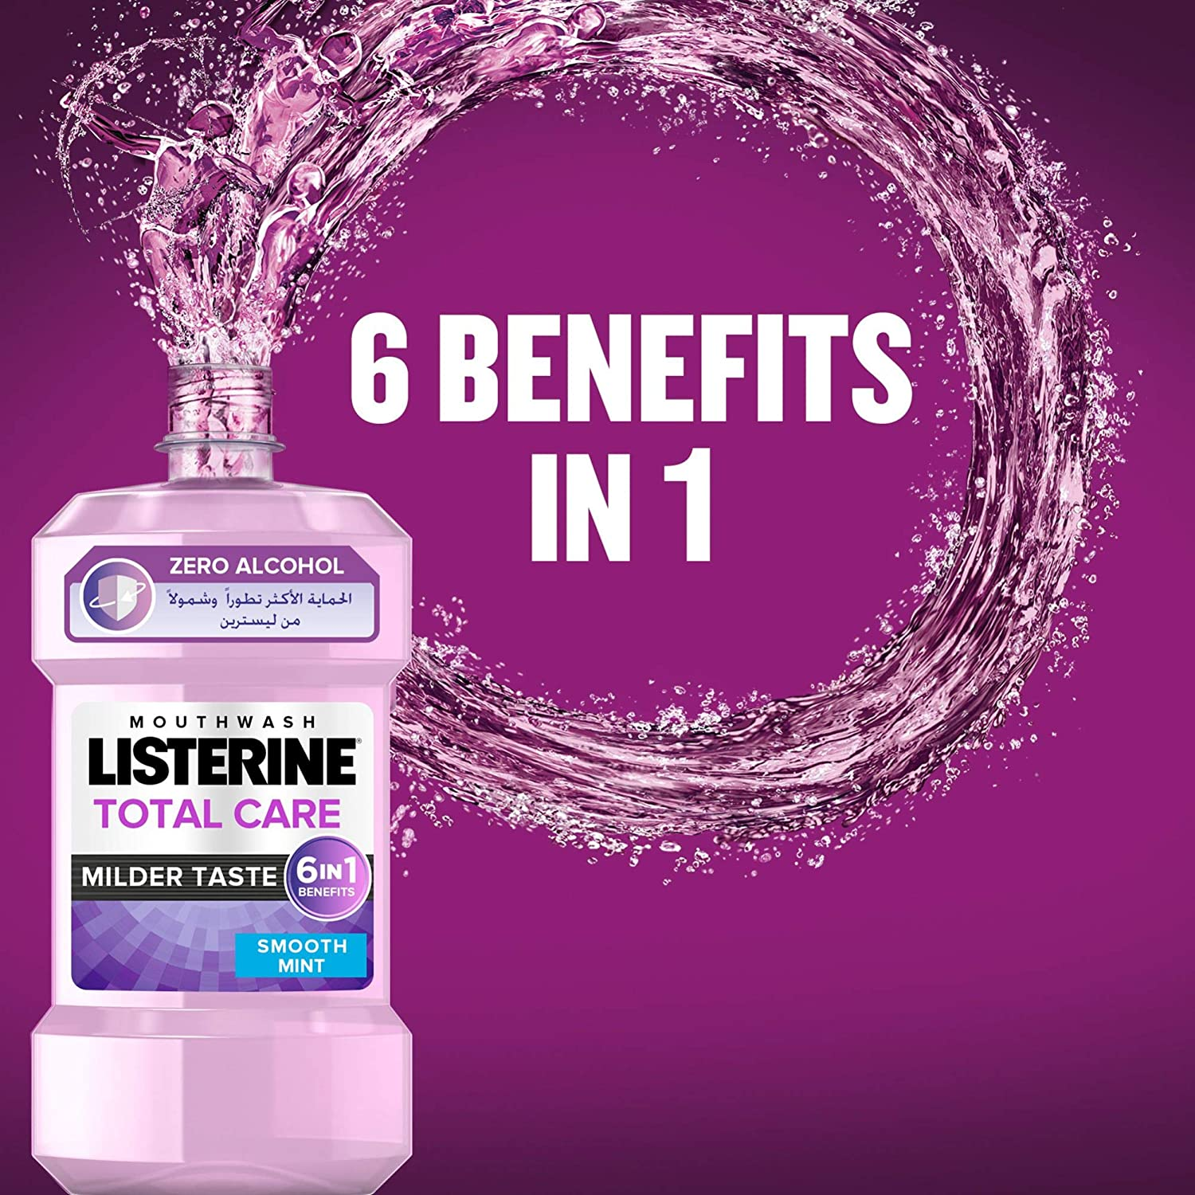
For Styrene
For Styrene Mouthwash Total Care Zero 250 ml
25.00 SAR. Q

Slide 4
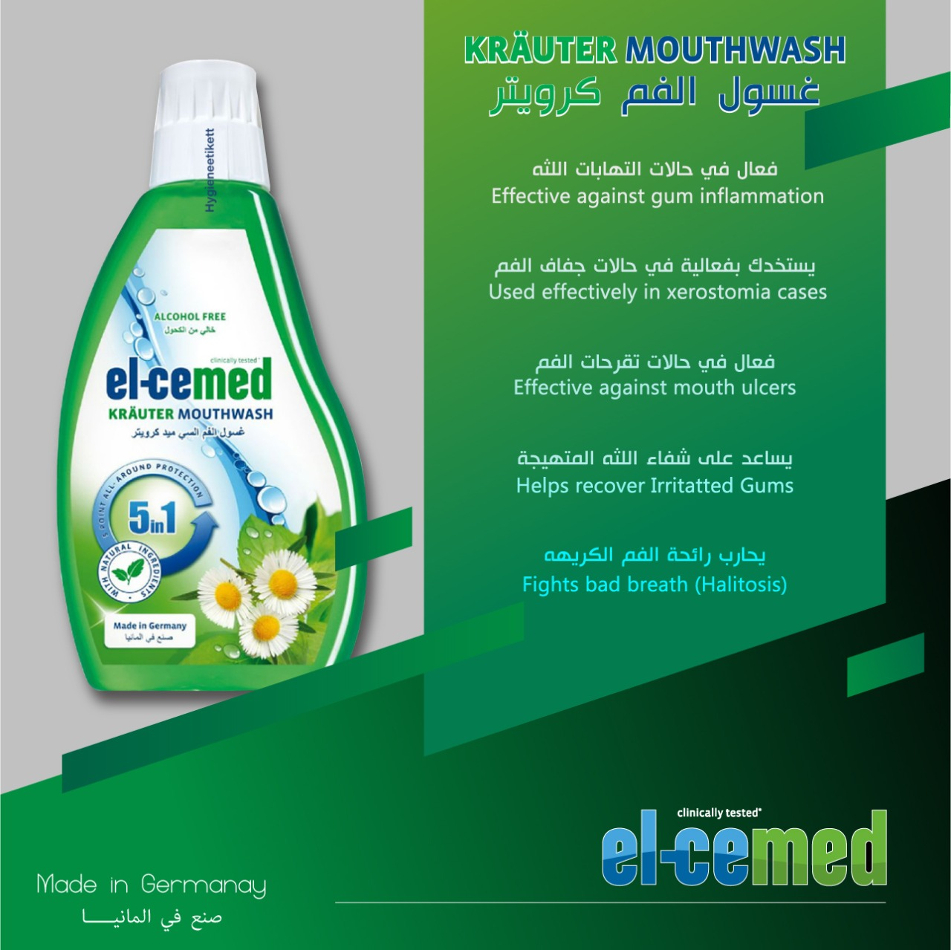
Semide
Mouthwash Semide Crawter 500ml
41.25 SAR. Q
The 500ml semide mouthwash contains a mixture of plant extracts and carbamide that remove plaque acids that attack teeth and bacteria that cause tooth decay. The mouthwash of semide can penetrate the spaces between the teeth with the added active ingredients to work on cleaning the teeth deeper as it protects against gum inflammation and soothes irritant gums. Semide mouthwash protects against five oral and dental problems including decay, gingivitis, bad breath and blackness.

